Slide 1



Slide 2
VR FIRE DRILL
Term Project
Course: Computer Programming For Engineers
Professor: Mohamad Eid
Kojo Vandyck - kev276
Emmanuel Fashae - eif213
Kenechukwu Ezeifemeelu - kee301

Slide 3
PRESENTATION OUTLINE
PERSONAL MOTIVE
WHY VR IS A BETTER OPTION THAN CONVENTIONAL FIRE DRILL
EQUIPMENT/SOFTWARE USED
LOGIC OF OUR CODE
DIAGRAMMATIC FRAMEWORK OF CODE
VISUAL DEMONSTRATION
PROBLEMS FACED
LESSONS FROM PROJECT
SOURCES OF RESEARCH
ANY QUESTIONS?

Slide 4

OUR PERSONAL MOTIVE

Slide 5
VR OVER REAL LIFE? - VRVis
VRVis is Austria's leading research institution in the field of visual computing and operates innovative research and development projects in cooperation with industrial companies and universities with its more than 70 employees.
VR drills are less costly
VR drills are more engaging
VR is relatively safe
VR drills are less time consuming
Multiple scenes can be generated
Not enough practicality

Slide 6
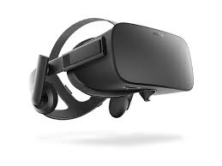
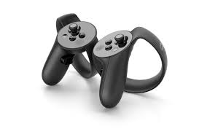
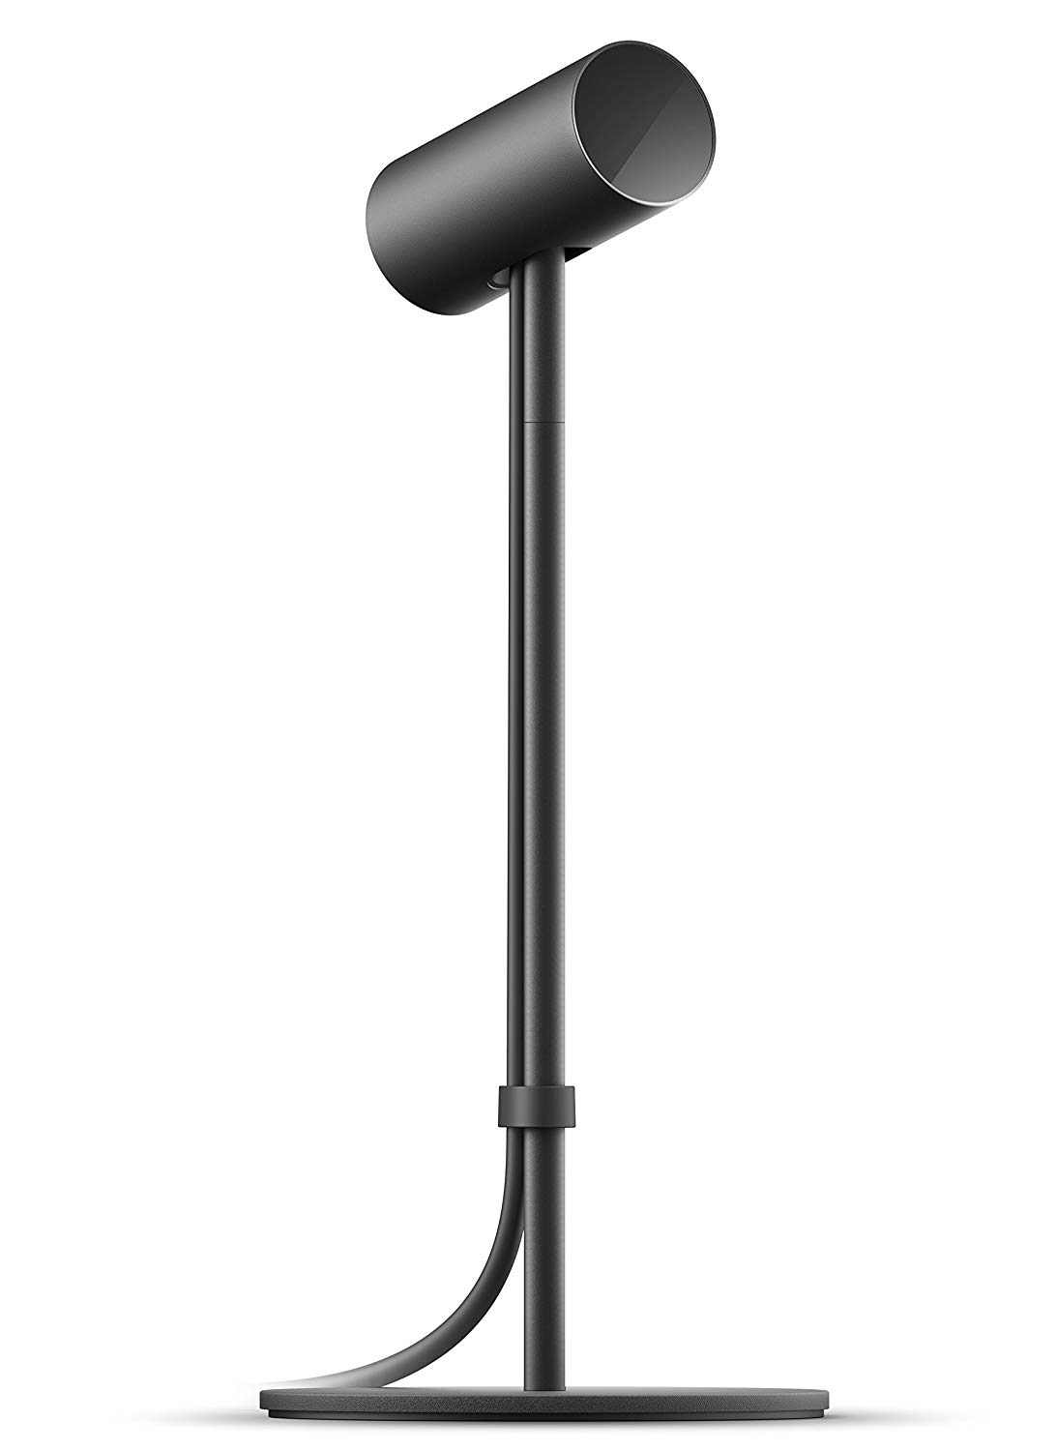

EQUIPMENT/SOFTWARE USED
Oculus Rift headset
Oculus touch left and right hand controller
Two Oculus Sensor
Unity

Slide 7
HOW THE PROJECT WORKS
GRAB FIRE EXTINGUISHER
TELEPORT TO DOOR
ENTER EXIT CODE ‘1111’
QUENCH FIRE 1
QUENCH FIRE 3
MESSAGE OF COMPLETION
TELEPORT TO NEXT FIRE
QUENCH FIRE 2

Slide 8
VISUAL DEMONSTRATION

Slide 9
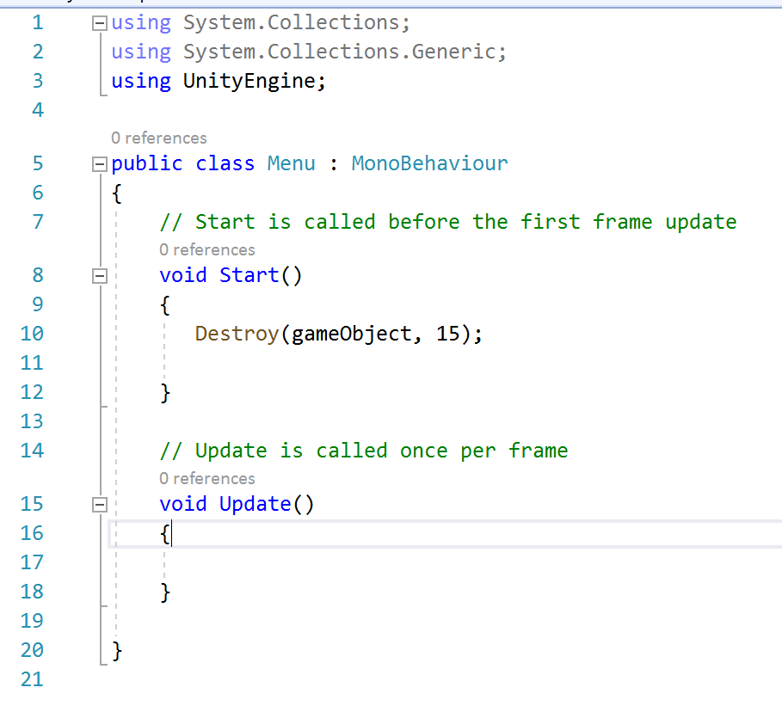
LOGIC OF OUR CODE 1
CODE TO REMOVE STARTING MESSAGE AFTER 15 SECS

Slide 10
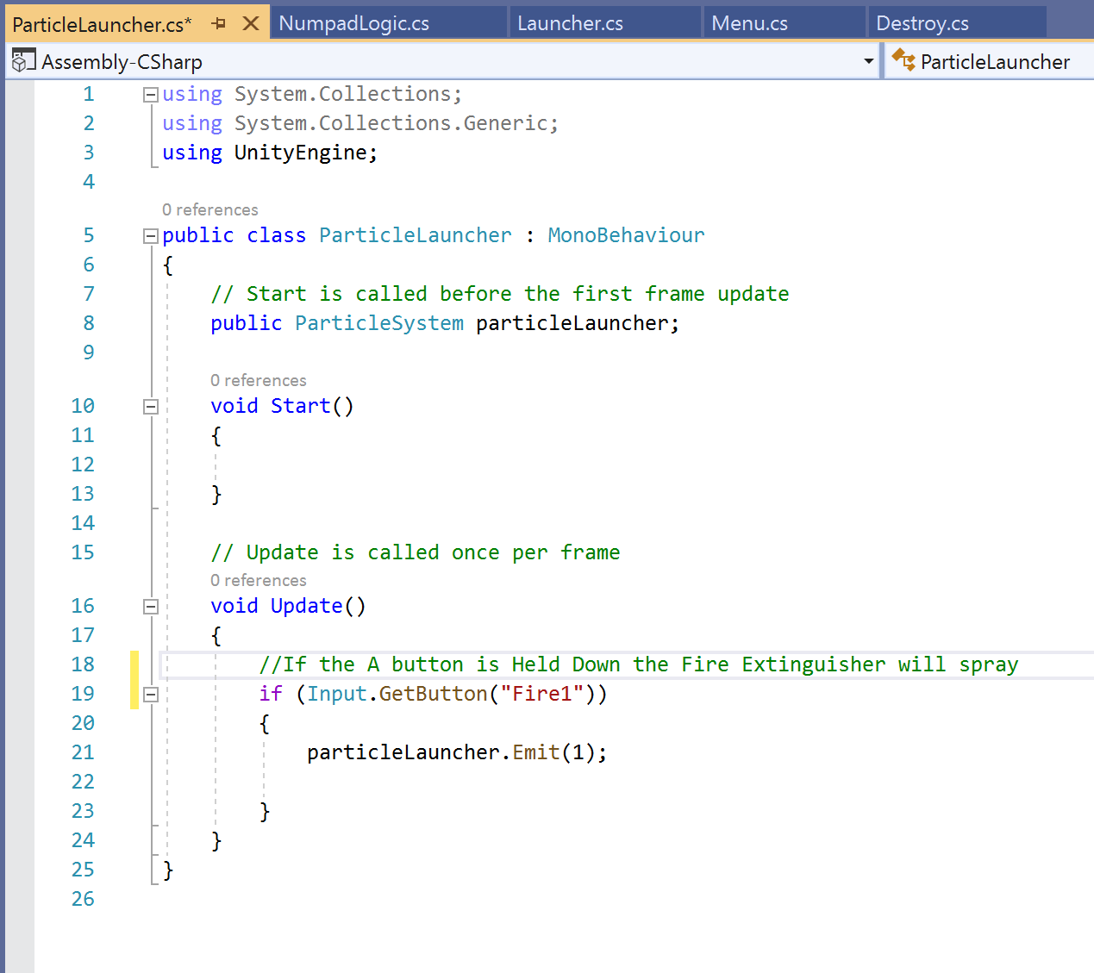
LOGIC OF OUR CODE 2
CODE TO ENABLE SPRAYING OF FIRE EXTINGUISHER

Slide 11
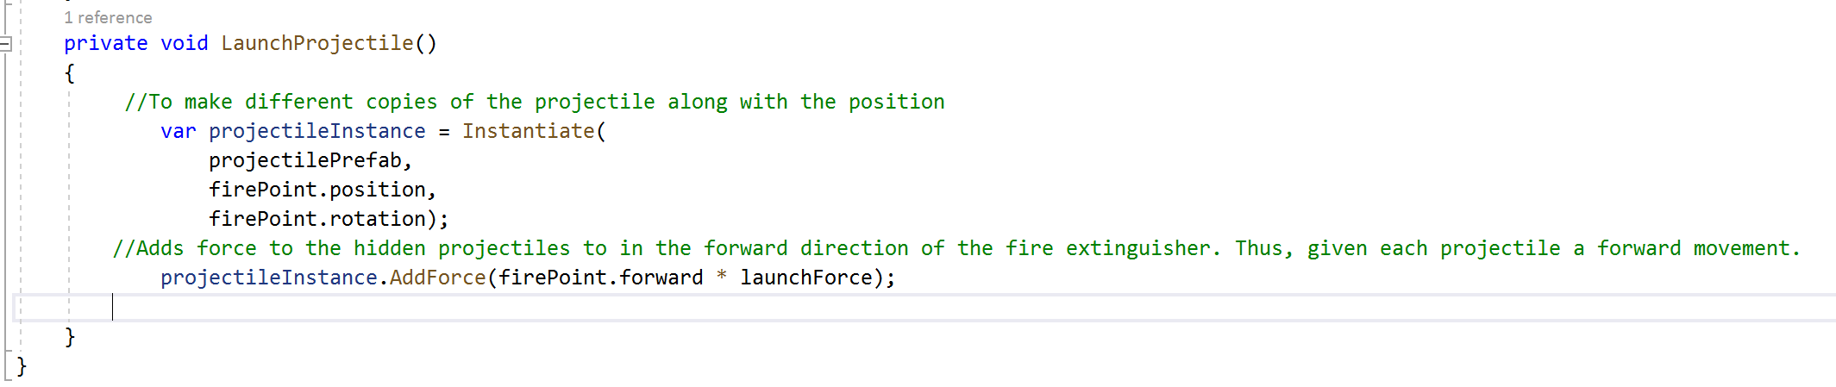
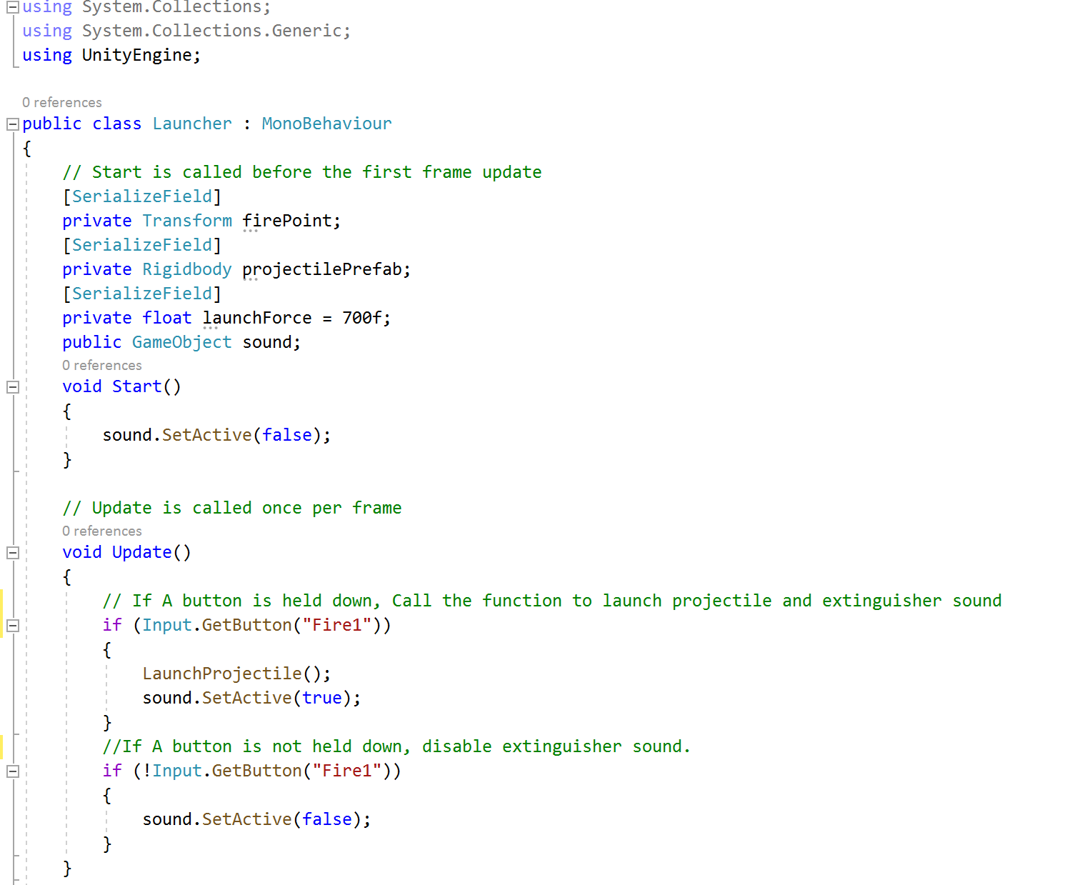
LOGIC OF OUR CODE 3
CODE TO SHOOT HIDDEN PROJECTILES FROM FIRE EXTINGUISHER

Slide 12
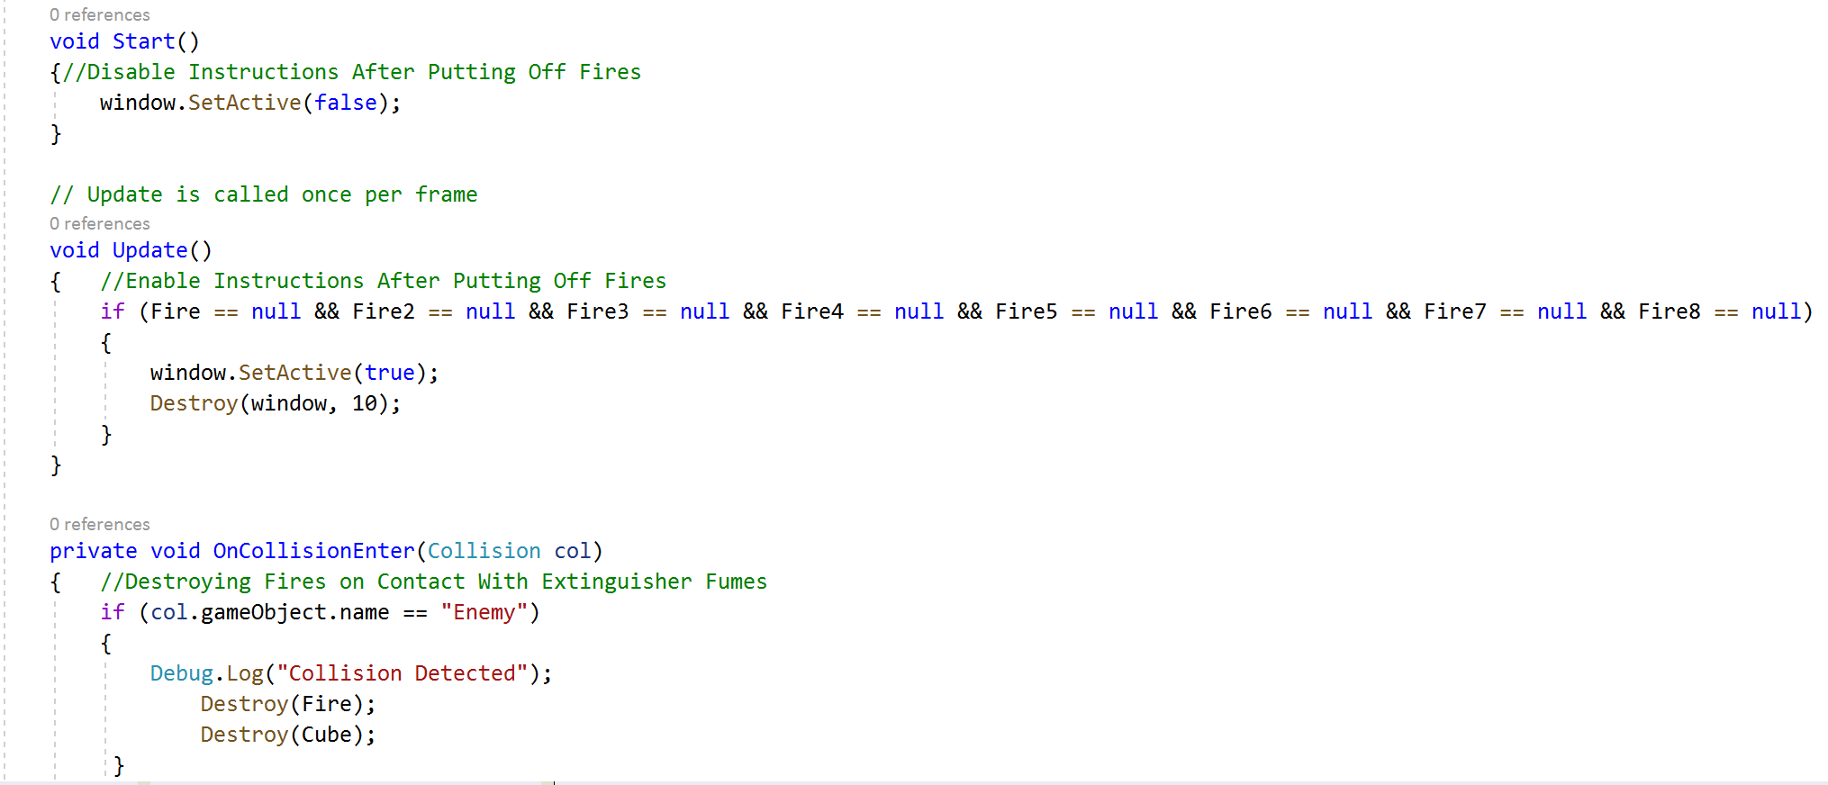
LOGIC OF OUR CODE 4
...
CODE TO DESTROY FIRE ON CONTACT WITH THESE PROJECTILES.
...

Slide 13
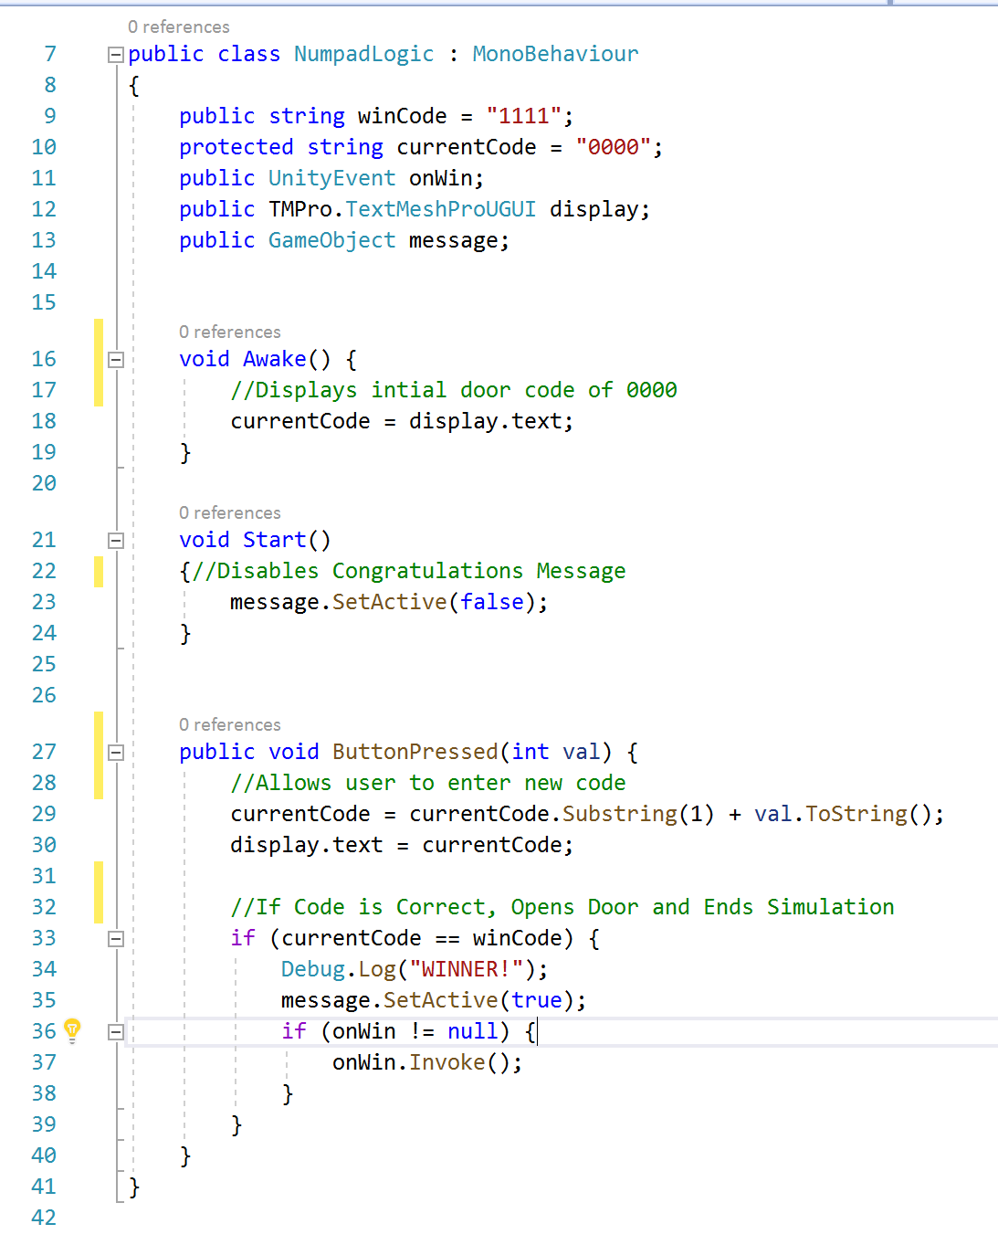
LOGIC OF OUR CODE 5
CODE TO OPEN DOOR AND END GAME.

Slide 14
DIFFICULTIES ENCOUNTERED
Making important changes in play mode
Object collision not working
Not Testing regularly on target devices
Not outlining engineering problem solving method and working with it
Problems with Physics and Colliders

Slide 15
LESSONS FROM PROJECT
Always save script changes before running
Names of objects should be specific to make them identifiable later on
If there’s a problem, test each script or function in a script with Debug.Log to make sure it actually works
Always create prefabs to be able to make changes to multiple objects in the scene
The importance of Public and Private access functions and/or objects
Understanding the physics behind rigid bodies
Taking time to understand the code rather than viewing online scripts

Slide 16
SOURCES OF RESEARCH
UNITY FORUM
UNITY YOUTUBE
UNITY LEARN
BRACKEYS
CODEACADEMY
UCLA HEALTH WEBSITE
VRVis RESEARCH CENTER

Slide 17
ANY QUESTIONS?

